Slide 1
Native vs Hybrid App Development
Understanding mobile app development options

Slide 3
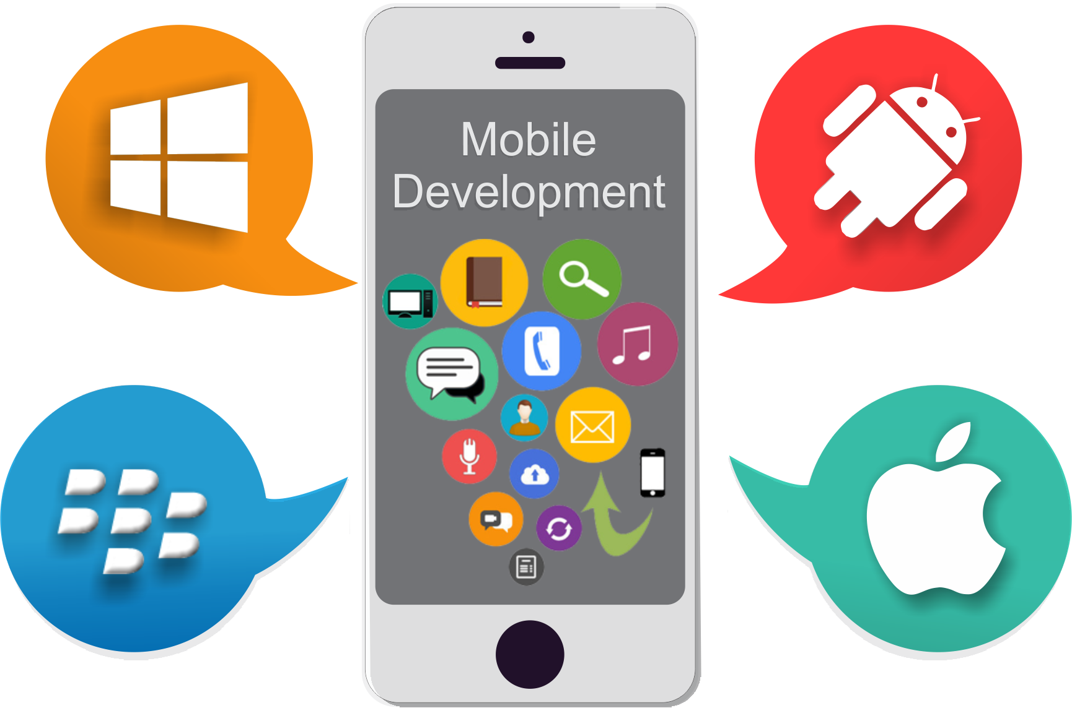

Slide 4
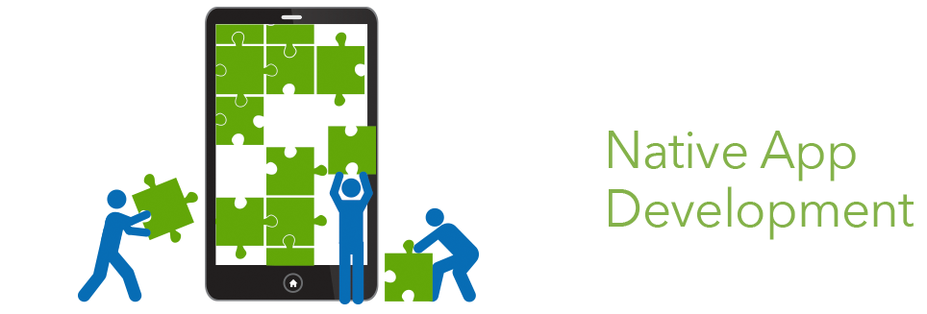

Slide 5
What is Native App Development?

Slide 6
What is Native App Development?
native programming languages of the devices to develop the app

Slide 7
What is Native App Development?
native programming languages of the devices to develop the app
specific to mobile platform using integrated development environment (IDE)

Slide 8
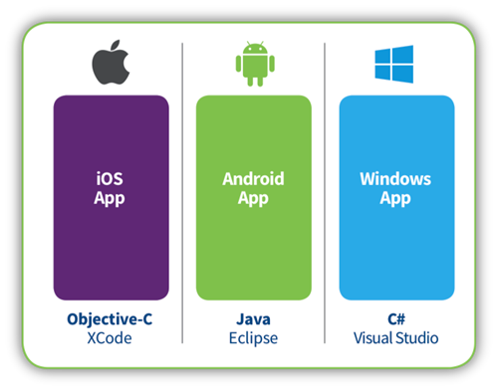

Slide 9
Apple has new programming language called “Swift”

Slide 10
Advantages of Native App Development
Fastest performance

Slide 11
Advantages of Native App Development
Fastest performance
Advanced UI interaction

Slide 12
Advantages of Native App Development
Fastest performance
Advanced UI interaction
Multi-touch support

Slide 13
Advantages of Native App Development
Fastest performance
Advanced UI interaction
Multi-touch support
Built-in components

Slide 14
Advantages of Native App Development
Fastest performance
Advanced UI interaction
Multi-touch support
Built-in components
Documentation

Slide 15
Disadvantages of Native App Development
Requires expertise in platform-specific language

Slide 16
Disadvantages of Native App Development
Requires expertise in platform-specific language
Takes much time to develop

Slide 17
Disadvantages of Native App Development
Requires expertise in platform-specific language
Takes much time to develop
Expensive to develop

Slide 18
Disadvantages of Native App Development
Requires expertise in platform-specific language
Takes much time to develop
Expensive to develop
Single platform only

Slide 19
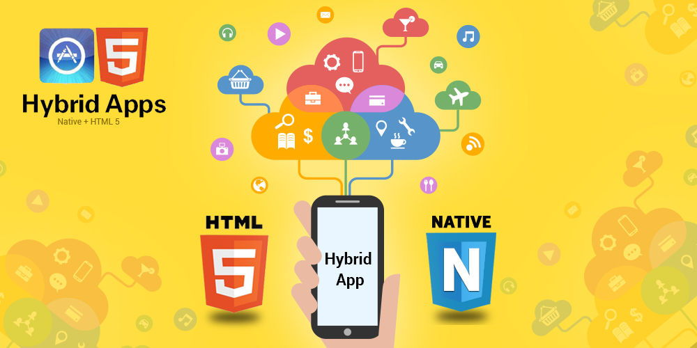

Slide 20
What is Hybrid App Development?

Slide 21
What is Hybrid App Development?
Combines both native and Web applications

Slide 22
What is Hybrid App Development?
Combines both native and Web applications
Write-once, run everywhere

Slide 23
What is Hybrid App Development?
Combines both native and Web applications
Write-once, run everywhere
Can easily be deployed across multiple platforms

Slide 24
Hybrid App Development Tools
PhoneGap (HTML, CSS, JS) ~ www.phonegap.com

Slide 25
Hybrid App Development Tools
PhoneGap (HTML, CSS, JS) ~ www.phonegap.com
Appcelerator Titanium (HTML, CSS, JS) ~ www.appcelerator.com

Slide 26
Hybrid App Development Tools
PhoneGap (HTML, CSS, JS) ~ www.phonegap.com
Appcelerator Titanium (HTML, CSS, JS) ~ www.appcelerator.com
Xamarin (C#) ~ www.xamarin.com

Slide 27
Hybrid App Development Tools
PhoneGap (HTML, CSS, JS) ~ www.phonegap.com
Appcelerator Titanium (HTML, CSS, JS) ~ www.appcelerator.com
Xamarin (C#, XAML) ~ www.xamarin.com
Rhomobile (HTML, CSS, JS, Ruby) ~ www.rhomobile.com

Slide 28
Advantages of Hybrid App Development
Portability (one code base, multiple platforms)

Slide 29
Advantages of Hybrid App Development
Portability (one code base, multiple platforms)
Access to Native APIs

Slide 30
Advantages of Hybrid App Development
Portability (one code base, multiple platforms)
Access to Native APIs
Web developer skills (HTML, CSS, JS)

Slide 31
Advantages of Hybrid App Development
Portability (one code base, multiple platforms)
Access to Native APIs
Web developer skills (HTML, CSS, JS)
Cost effective

Slide 32
Disadvantages of Hybrid App Development
Does not provide best UI (look and feel)

Slide 33
Disadvantages of Hybrid App Development
Does not provide best UI (look and feel)
Limitations on implementing features

Slide 34
Disadvantages of Hybrid App Development
Does not provide best UI (look and feel)
Limitations on implementing features
Debugging can be time-consuming

Slide 35
Native vs Hybrid
Native:
Best user experience and high performance

Slide 36
Native vs Hybrid
Native:
Best user experience and high performance
Best for games, or hardware-integrated apps

Slide 37
Native vs Hybrid
Native:
Best user experience and high performance
Best for games, or hardware-integrated apps
Documentation and ease of use

Slide 38
Native vs Hybrid
Native:
Best user experience and high performance
Best for games, or hardware-integrated apps
Documentation and ease of use
Hybrid:
Fast development

Slide 39
Native vs Hybrid
Native:
Best user experience and high performance
Best for games, or hardware-integrated apps
Documentation and ease of use
Hybrid:
Fast development
Platform-independent

Slide 40
Native vs Hybrid
Native:
Best user experience and high performance
Best for games, or hardware-integrated apps
Documentation and ease of use
Hybrid:
Fast development
Platform-independent
Overall lower budget cost

Slide 41
Wrapping Up
Both native and hybrid apps have pros and cons

Slide 42
Wrapping Up
Both native and hybrid apps have pros and cons
Determine your needs to choose which of them to use

Slide 43
Wrapping Up
5 Questions to ask before you decide:
Do you need to use native features such as GPS, Camera, Contacts, SMS?

Slide 44
Wrapping Up
5 Questions to ask before you decide:
Do you need to use native features such as GPS, Camera, Contacts, SMS?
Native wins

Slide 45
Wrapping Up
5 Questions to ask before you decide:
2. How quickly do you want to market your app?

Slide 46
Wrapping Up
5 Questions to ask before you decide:
2. How quickly do you want to market your app?
Hybrid wins

Slide 47
Wrapping Up
5 Questions to ask before you decide:
3. Do you have knowledge in both iOS and Android app development and want to build critical-based apps?

Slide 48
Wrapping Up
5 Questions to ask before you decide:
3. Do you have knowledge in both iOS and Android app development and want to build critical-based apps?
Native wins

Slide 49
Wrapping Up
5 Questions to ask before you decide:
4. How often do you need to update your app?

Slide 50
Wrapping Up
5 Questions to ask before you decide:
4. How often do you need to update your app?
Hybrid wins

Slide 51
Wrapping Up
5 Questions to ask before you decide:
5. Do you want to have the best user experience?

Slide 52
Wrapping Up
5 Questions to ask before you decide:
5. Do you want to have the best user experience?
Native wins

Slide 53
Thanks for listening! :)
Mary Sabio me@msaysabio.com

